Slide 1


K.RAMAKRISHNAN COLLEGE OF ENGINEERING
(AUTONOMOUS)
ECC1394
SIGNAL PROCESSING FOR mmWAVE COMMUNICATION
ADAPTIVE DIGITAL CALIBRATION FRAMEWORK FOR MMWAVE SYSTEMS USING LEAST SQUARES ESTIMATION
TEAM MEMBERS :
SHAHIN ASHIKA K – 8115U23EC097
SHRUTHI R – 8115U23EC102
SRI AMIRTHA VARSHINI S V – 8115U23EC108
SRI VIDHYA B – 8115U23EC110
GUIDED BY
Mrs.S.JANUPRIYA M.Tech.,(Ph.D),
ASSISTANT PROFESSOR
ECE / KRCE

Slide 2
CONTENTS
ABSTRACT
INTRODUCTION
PROBLEM STATEMENT
EXISTING SYSTEM
PROPOSED SYSTEM
FLOW CHART
MODULES USED
BLOCK DIAGRAM
APPLICATIONS
RESULTS AND DISCUSSION
CONCLUSION AND FUTURE SCOPE

Slide 3
ABSTRACT
Millimeter wave (mmWave) communication systems are widely used in 5G and future 6G networks due to their high data rate capability. However, practical mmWave systems suffer from hardware impairments such as gain mismatch, phase offset, and I/Q imbalance, which degrade system performance. This project presents a software-based calibration approach using signal processing algorithms to estimate and compensate these impairments. Pilot-based least squares estimation is used for error correction, and system performance is evaluated using BER and constellation analysis. Simulation results show improved signal quality after calibration.

Slide 4
INTRODUCTION
Millimeter wave communication operates at very high frequencies and is a key technology for modern wireless systems such as 5G and 6G. Due to hardware limitations and RF imperfections, mmWave systems experience performance degradation. Calibration is therefore essential to ensure accurate signal transmission and reception.This project focuses on software-based calibration, which reduces the need for expensive hardware solutions and improves system reliability using digital signal processing techniques.

Slide 5
PROBLEM STATEMENT
In practical mmWave communication systems, hardware impairments such as gain mismatch, phase errors, and I/Q imbalance cause signal distortion and beam misalignment. Traditional hardware-based calibration methods are costly and complex. There is a need for a low-cost, flexible, and software-based calibration technique that can effectively estimate and compensate these impairments to improve mmWave system performance.

Slide 6
EXISTING SOLUTION
In existing mmWave systems, calibration is mostly performed using hardware components and manual tuning methods. These approaches increase system cost, complexity, and power consumption. Many systems do not provide real-time or adaptive calibration, leading to degraded performance under varying conditions. Additionally, traditional methods lack flexibility and scalability for future communication systems.

Slide 7
PROPOSED SOLUTION
The proposed system uses software-based calibration techniques to estimate and compensate mmWave hardware impairments.
Pilot-based signal transmissionLeast Squares (LS) estimation for error calculation
Digital compensation of gain, phase, and I/Q imbalance
Performance evaluation using BER and constellation plots
This approach eliminates additional hardware and improves system efficiency.

Slide 8
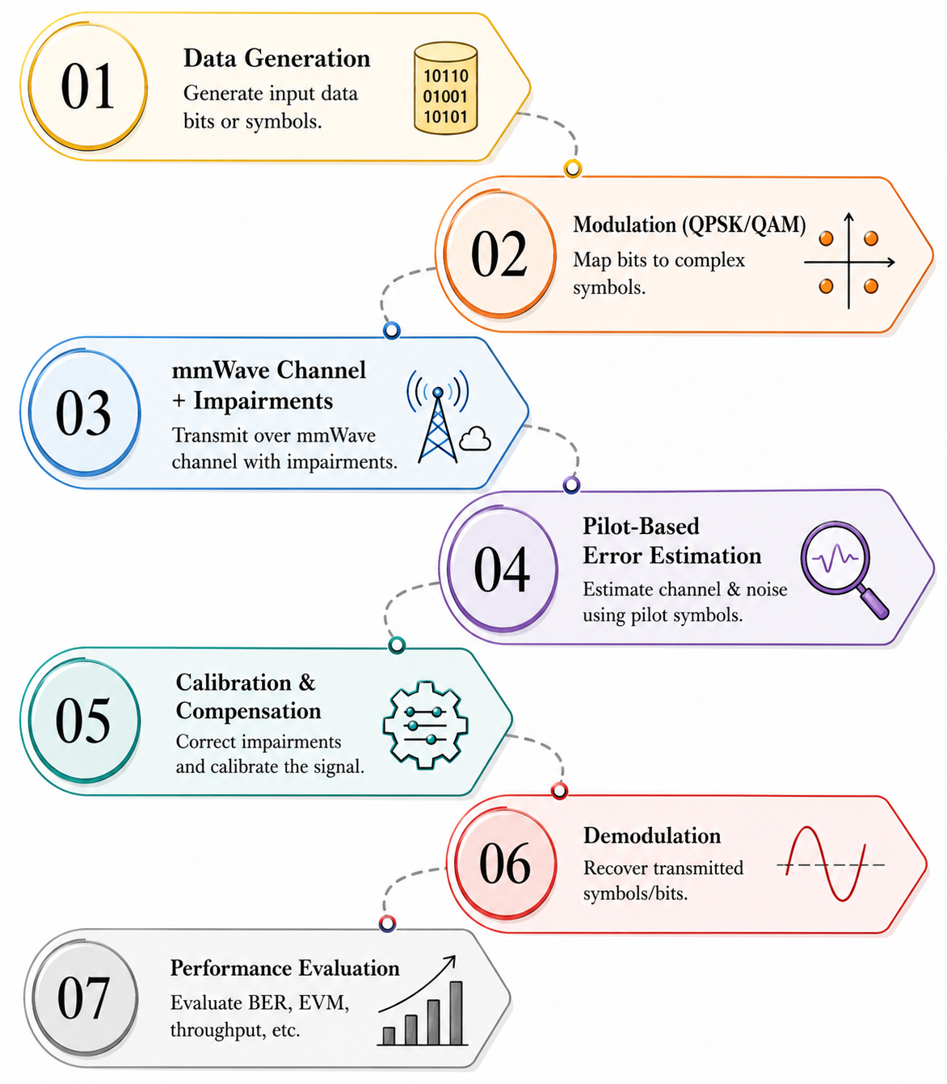

FLOW CHART

Slide 9
MODULES USED
Data Generator:
The data generator creates random binary data bits that act as the input to the communication system. These bits represent the information to be transmitted through the mmWave channel. The generated data is then forwarded to the modulation stage for signal conversion.
2. Modulation Module:
The modulation module converts digital data into modulated symbols using techniques such as QPSK or QAM. This process helps in efficient transmission of data over wireless channels. Modulation improves bandwidth utilization and supports high-speed communication.

Slide 10
MODULES USED
3. mmWave Channel Model:
The mmWave channel model simulates real wireless communication conditions. It introduces effects such as noise, path loss, and phase noise into the transmitted signal. This helps in analyzing system performance under practical channel environments.
4. Impairment Module:
The impairment module introduces hardware imperfections into the signal. These impairments include gain mismatch, phase offset, and I/Q imbalance, which distort the transmitted signal. This stage helps in evaluating the effectiveness of the calibration process.

Slide 11
MODULES USED
5. Pilot-Based Estimation & Calibration Module:
This module uses pilot signals and the Least Squares (LS) algorithm to estimate impairments present in the received signal. The estimated gain mismatch, phase offset, and I/Q imbalance are digitally compensated using calibration techniques. This process improves signal quality and reduces distortion.
6. Performance Evaluation Module:
This module evaluates the overall system performance using parameters such as Bit Error Rate (BER) and constellation diagrams. The received signal before and after calibration is compared to measure improvement. The results confirm the effectiveness of the proposed calibration framework.

Slide 12
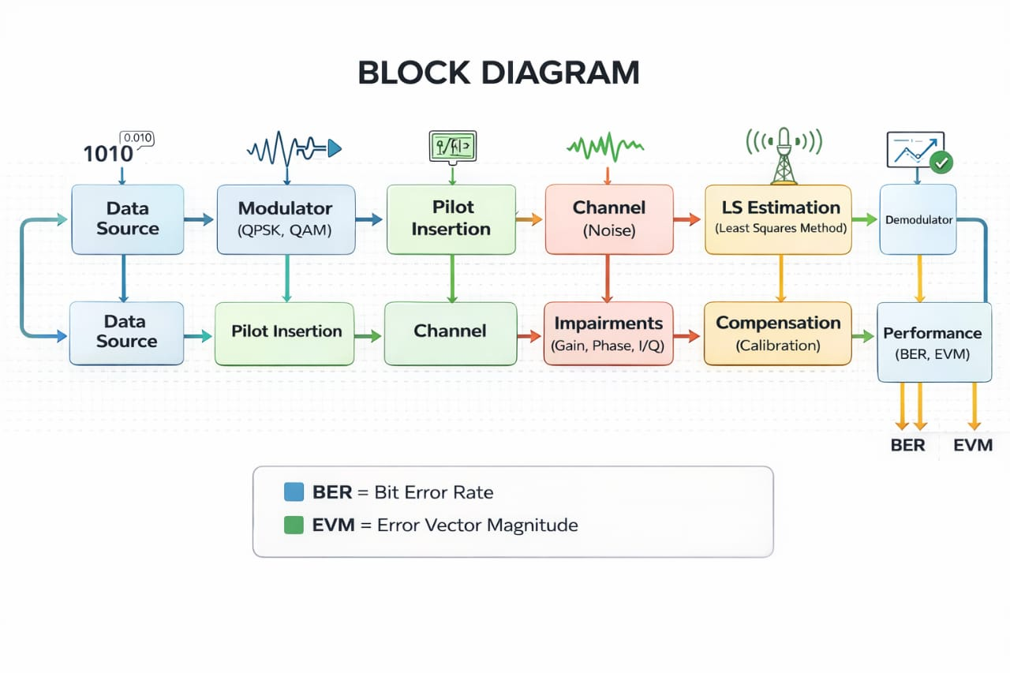
BLOCK DIAGRAM

Slide 13
APPLICATIONS
5G and future 6G base stations
Massive MIMO wireless communication systems
Automotive radar and autonomous vehicles
Satellite and space communication systems
High-speed wireless backhaul links
mmWave test and measurement systems

Slide 14
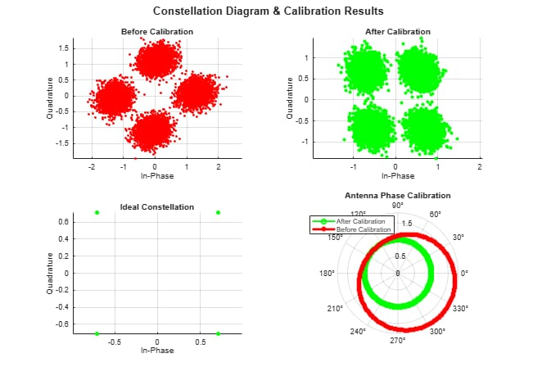
RESULTS & DISCUSSION

Slide 15
COMPARISON TABLE
Algorithm Name | Filter / Method Used | Observation from Output | BER / Performance | BER Values
LS (Least Squares) ⭐ | Pilot-based estimation filter | Constellation becomes well aligned after calibration | Low BER | 0.004
LMS (Least Mean Squares) | Adaptive error minimization filter | Improves clustering gradually | Medium BER | 0.043
RLS (Recursive Least Squares) | Recursive estimation filter | Good accuracy but complex | Medium BER | 0.018
Kalman Filter | State estimation filter | Stable estimation | Medium BER | 0.009
DNN (Deep Learning) | Neural network calibration | Advanced technique but not used here | Not evaluated | --

Slide 16
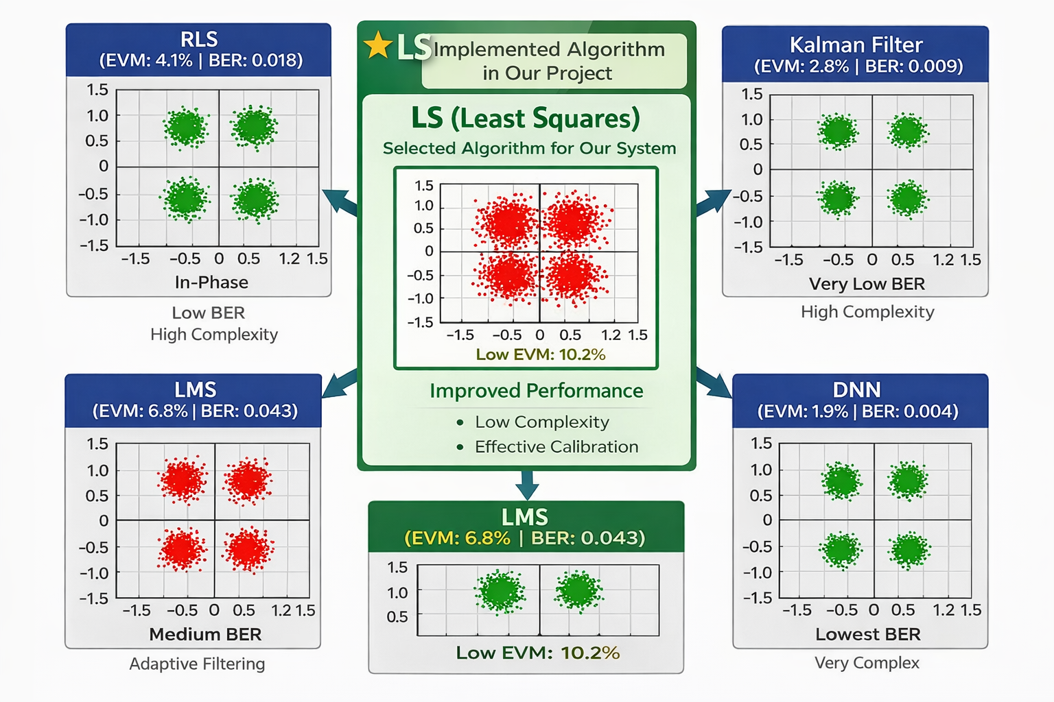
OUTPUTS

Slide 17
CONCLUSION & FUTURE SCOPE
This project successfully demonstrates a software-based calibration technique for millimeter wave communication systems using signal processing algorithms. The proposed method effectively compensates hardware impairments and improves system performance in terms of BER and signal quality.
Future Scope
Extension to OFDM-based mmWave systems
Antenna array and beamforming calibration
Adaptive and real-time calibration algorithms
Application to massive MIMO and 6G systems

Slide 18


